Slide 1
Lying With Data
By: Sean Lee

Slide 2
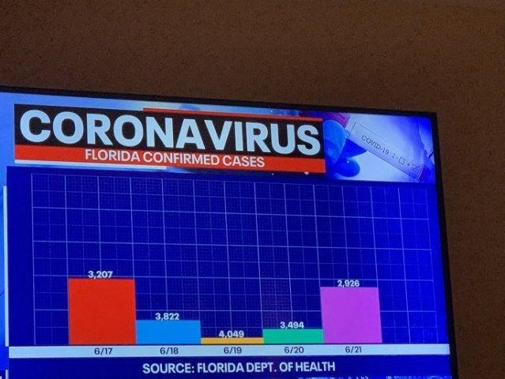
Disproportionate Scale:
This data visualization is misleading because the days with higher confirmed Coid-19 cases have a smaller bar plot
The goal of this data visualization was to show that the number of confirmed Covid-19 cases is getting lower over the 5 days
A correct visualization would have the correct scales to show that there is a jump in cases on 6/19 that comes back down on 6/21

Slide 3
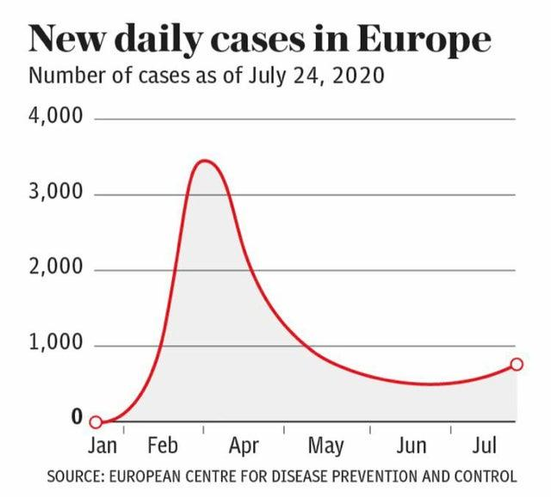
Misleading X-Axis:
The line chart has a misleading x-axis
The x-axis omits the entire month of March
The goal of the line chart is to show a sudden spike in daily cases between February and April
A correct data visualization would include the month of march to show that there was a more gradual increase of cases

Slide 4
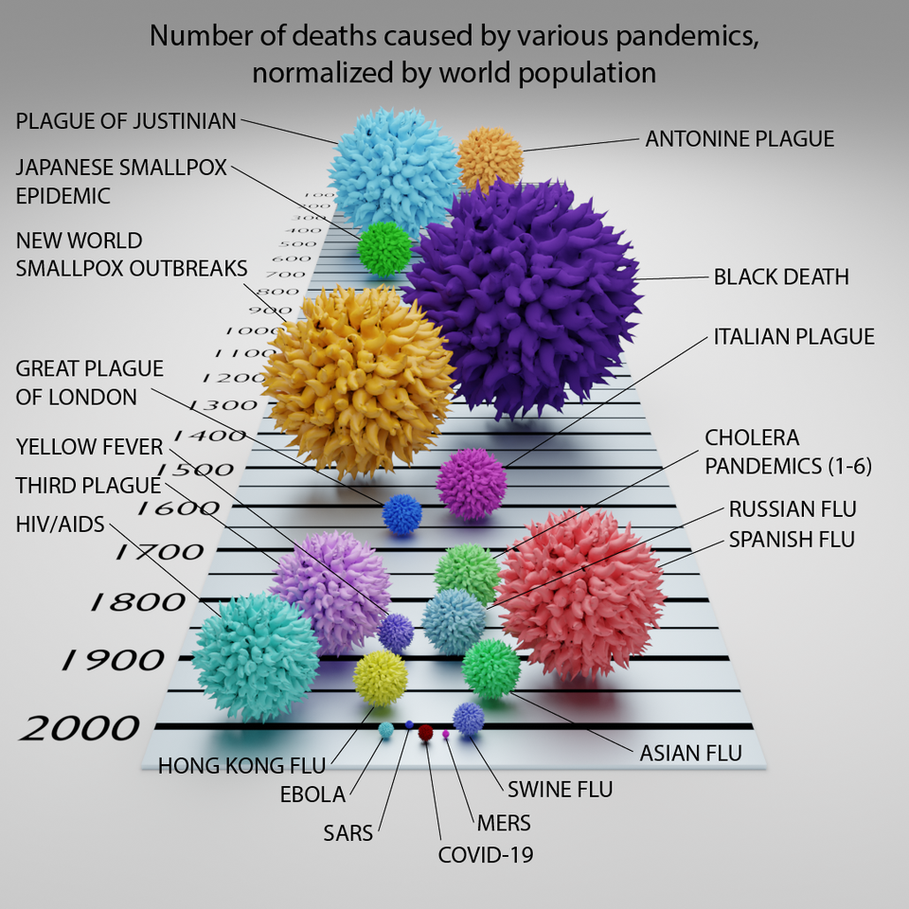
Misleading Scale:
This data visualization only has a single axis (the century) and has no other point of reference
The reader is to assume that the larger spheres means a higher death count
The goal of this data visualization is to show that Covid-19 deaths are not as high compared to other pandemics

Slide 5
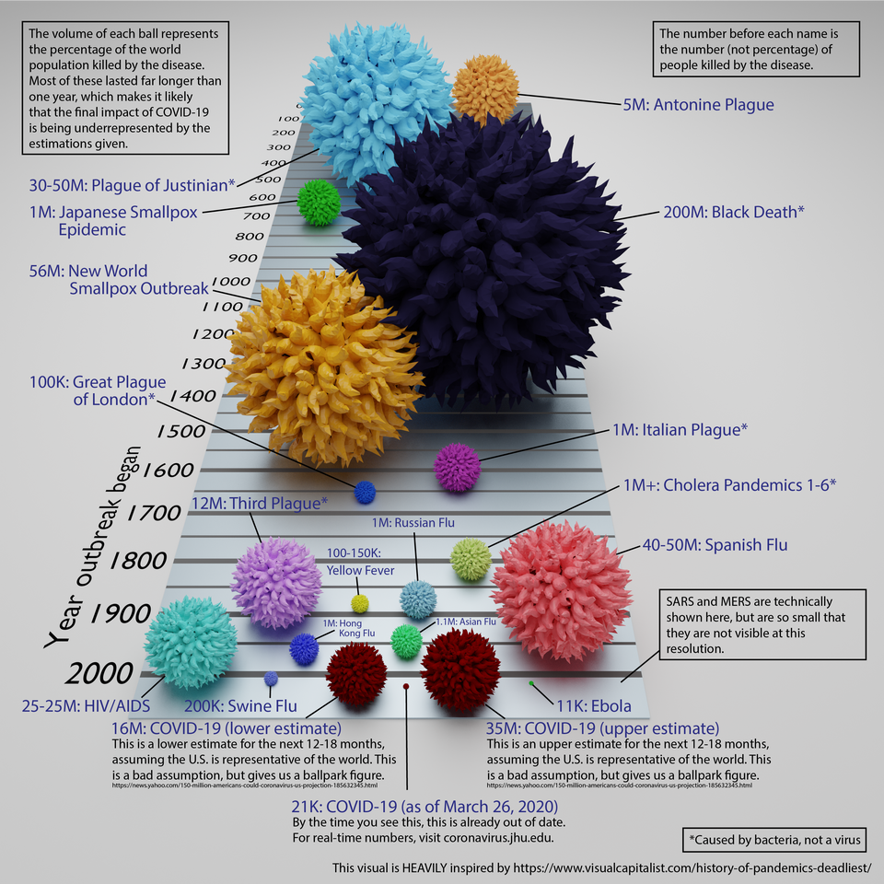
Misleading Scale (Corrected):
The corrected version of the data visualization shows the number of deaths associated with each pandemic
Each pandemic is a different color so the viewer can easily identify and distinguish between diseases
Information on Covid-19 is written at the bottom to explain the current number of deaths and a lower and upper bound for the disease

